Slide 1




Poster: 335
Non-Compensatory Psychological Models for Recommendation Systems
Chen Lin, Xiaolin Shen, Si Chen, Muhua Zhu, Yanghua Xiao
□Research Question1:
How do we explain existing recommendation models psychologically?
Compensatory Rules
$$\hat{x_{u,q}}=q_{1}u_{1}+⋯+q_{K}u_{K}$$
Collaborative Filtering: UserKNN, itemKNN
Rating models: MF, AMF, LLORMA
Ranking models: BPR, Bradley-Terry
Most existing models are compensatory
A good performance on one aspect compensates for bad performances on other aspects
Decision
Process
Non-Compensatory Rules
Lexicographic
Conjunctive
More commonly adopted in real life

Slide 2

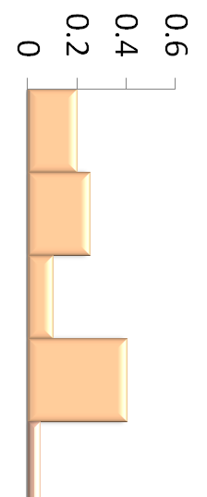
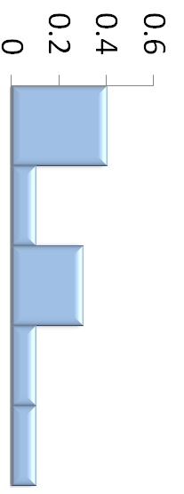
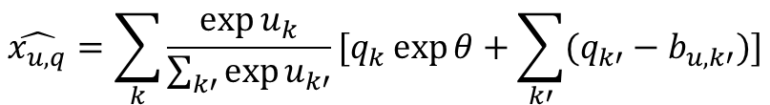
□Research Question2:
Can we develop non-compensatory recommendation models?
Compensatory Rules
Cut-off point
Decision
Process
Conjunctive
Non-Compensatory Rules
$$\hat{x_{u,q}}=\sum_{k}{\frac{\exp{u_{k}}}{\sum_{k′}{\exp{u_{k′}}}}[q_{k}\exp{θ}+\sum_{k′}{(q_{k′}−b_{u,k′})}]}$$
Lexicographic
Combination of 2 rules
Realization to rating and ranking models
Universally improve recommendation performance for different existing models on a variety of data sets
Prominent aspect

